Slide 1

LYNN KYALO kyalolynn036@gmail.com Identifying Safe Aircraft Models for Company Expansion
Aviation Accident Analysis for Safer Aircraft Selection

Slide 2
Problem statement
A company is diversifying into new industries and plans to expand into aviation. Specifically, the company aims to purchase and operate airplanes for both commercial and private enterprises.
However , they currently lack expertise regarding the potential risks associated with different aircraft types.
To successfully launch this new business, they must identify the aircraft models with the lowest risk, based on historical accident and incident records. Making data-driven decisions is crucial to minimize safety risks, protect the company’s reputation, and ensure operational success in aviation

Slide 3
Project objectives
Analyze historical aviation accident data from 1962 to 2023.
Identify aircraft makes and models associated with the lowest accident and fatality rates.
Clean and prepare the data to ensure accurate and reliable analysis.
Develop clear, data-driven visualizations to highlight key insights.
Provide actionable recommendations to guide the company's aircraft purchasing decisions.

Slide 4
Importance of the project
Risk Reduction: Selecting safer aircraft minimizes operational risks and enhances passenger safety.
Cost Efficiency: Lower accident rates translate to reduced insurance costs, maintenance, and legal liabilities.
Reputation Management: Operating safe and reliable aircraft protects the company's brand image.
Strategic Growth: Entering aviation with a strong, data-backed foundation supports long-term business success.
Regulatory Compliance: Ensures alignment with aviation safety standards and industry regulations.

Slide 5
Data set description
Source: National Transportation Safety Board (NTSB).
Time Period: 1962 to 2023 (over 60 years of aviation accident records).
Coverage: Civil aviation accidents and selected incidents in the United States and international waters.
Key Features:
Aircraft make and model
Injury severity (fatal, serious, minor, none)
Accident location (latitude, longitude)
Event date and publication date
Narrative descriptions
Flight phase and purpose
Weather conditions
Challenges Encountered:
Significant missing values across multiple fields.
Variability in aircraft naming and descriptions.
Presence of irrelevant columns not necessary for analysis.

Slide 6
Make | Manufacturer of the aircraft
Model | Specific model of the aircraft
Injury Severity | Outcome of the accident (fatal, serious, etc.)
Event Date | Date when the accident occurred
Latitude & Longitude | Location coordinates of the accident
Aircraft Damage | Extent of damage to the aircraft
Weather Condition | Weather during the accident
Broad Phase of Flight | Flight phase (takeoff, landing, cruise, etc.)
Purpose of Flight | Type of flight (business, personal, etc.)

Slide 7
Data cleaning and preparation
To ensure reliable and accurate analysis, I applied the following steps to clean and prepare the data:
1. Dropped Columns: Columns with over 60% missing values were removed to reduce noise and focus on meaningful information.
2. Removed Incomplete Rows: Rows missing essential details like Latitude, Longitude, Make, Model, or Injury Severity were excluded to maintain data integrity.
3. Standardized Column Names: Dots and spaces in column names were replaced with underscores, and all names were converted to lowercase for consistency.
4. Converted Date Columns: Fields like event_date and publication_date were converted to datetime format for accurate time-based analysis.
5. Dealt with Missing Values: Where possible, non-critical missing values were either imputed or left if they did not impact the analysis focus.
After cleaning, the dataset had 87,798 rows and 25 useful features ready for analysis

Slide 8
Exploratory Data Analysis (EDA)
The goal of EDA was to uncover patterns, trends, and relationships in the aircraft accident data to help identify low-risk aircraft options.
Key Explorations Performed:
1. Injury Severity Distribution: Analyzed how accidents were classified (e.g., fatal, serious, minor, none) to understand the overall safety landscape.
2. Aircraft Types with Most Accidents: Identified which aircraft types (fixed-wing, helicopters, etc.) were involved in the highest number of incidents.
3. Manufacturer Trends: Studied accident counts by aircraft manufacturers (e.g., Cessna, Piper) to spot consistently safer brands.
4. Fatality Rates per Aircraft Type and Model: Calculated and compared fatality rates to focus on aircraft with lower chances of fatal accidents.
5. Accident Frequency per Aircraft Model: Assessed how frequently different models were involved in accidents to prioritize safer choices.
The insights gained from this analysis were visualized to guide the final aircraft recommendations.

Slide 9
📊 Visualization 1: Injury Severity Distribution
I analyzed the severity of injuries reported in aviation accidents.
Key Findings:
Most accidents resulted in no injuries or minor injuries.
A small percentage of accidents led to fatal injuries.
Decision Impact:
This shows that while accidents are common, most are not fatal, helping the company assess overall industry safety.
Chart Type:
Bar Chart showing the number of accidents per injury severity category

Slide 10
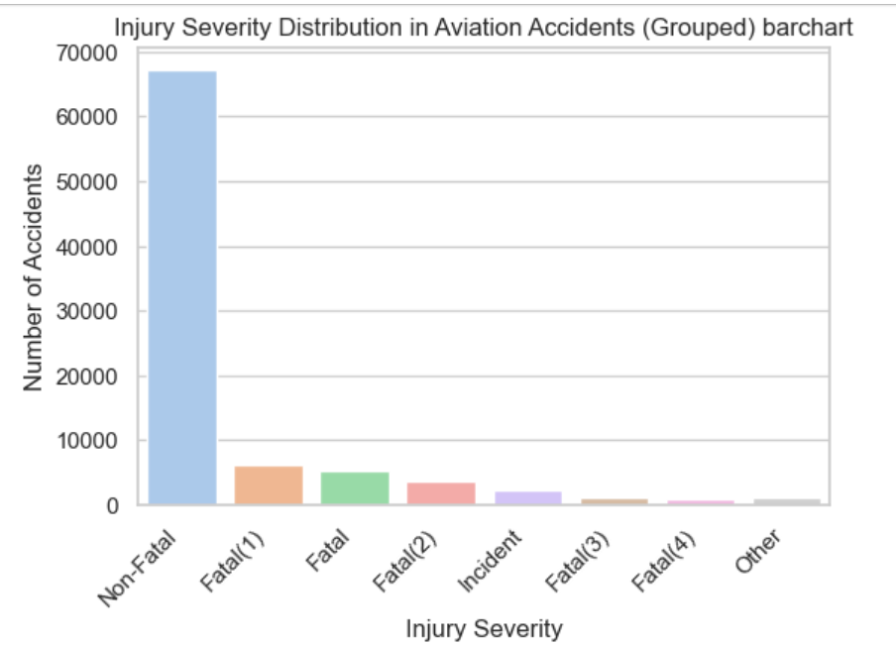

Slide 11
Visualization 2 - Aircraft Models with Highest Accident Counts
This visualization shows the aircraft models that have experienced the highest number of accidents.
A horizontal bar chart was used to make it easy to compare models at a glance.
Focused on the top models with the most reported accidents.
Insights
Certain aircraft models have a significantly higher number of accidents than others.
This information helps identify models that may carry higher operational risks.
Models with consistently high accident counts may require further evaluation before purchase

Slide 12
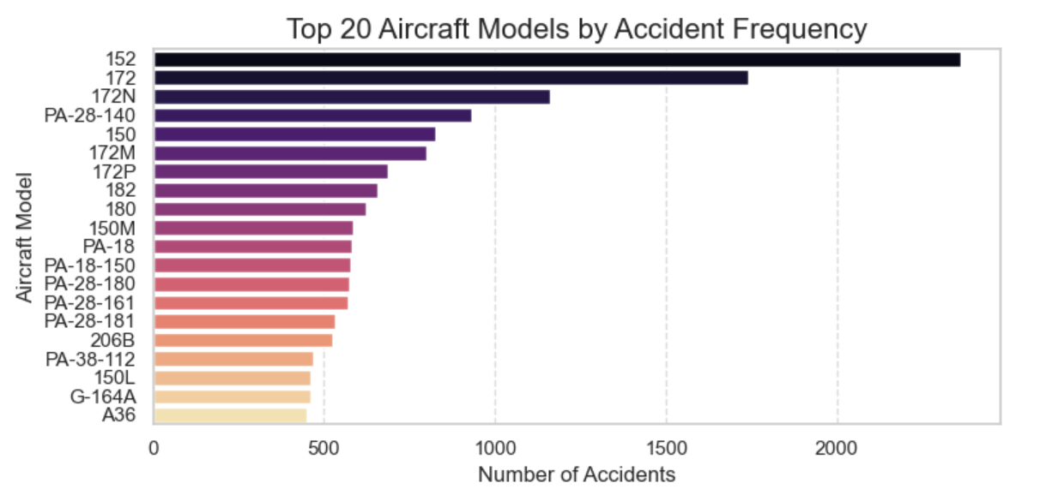

Slide 13
Visualization 3 - Aircraft Models by Fatality Rate
Displayed a horizontal bar chart showing the top 20 aircraft models and their corresponding fatality rates.
Fatality rate = (Fatal accidents) ÷ (Total accidents) for each model.
This visualization highlights which aircraft models have historically been more dangerous, regardless of accident frequency.
Key Insights:
Some models with fewer total accidents still had higher fatality rates, indicating higher risk.
Aircraft with both high accident counts, and high fatality rates are especially concerning.
Aircraft with low fatality rates even after accidents are safer and more favorable for purchase.

Slide 14
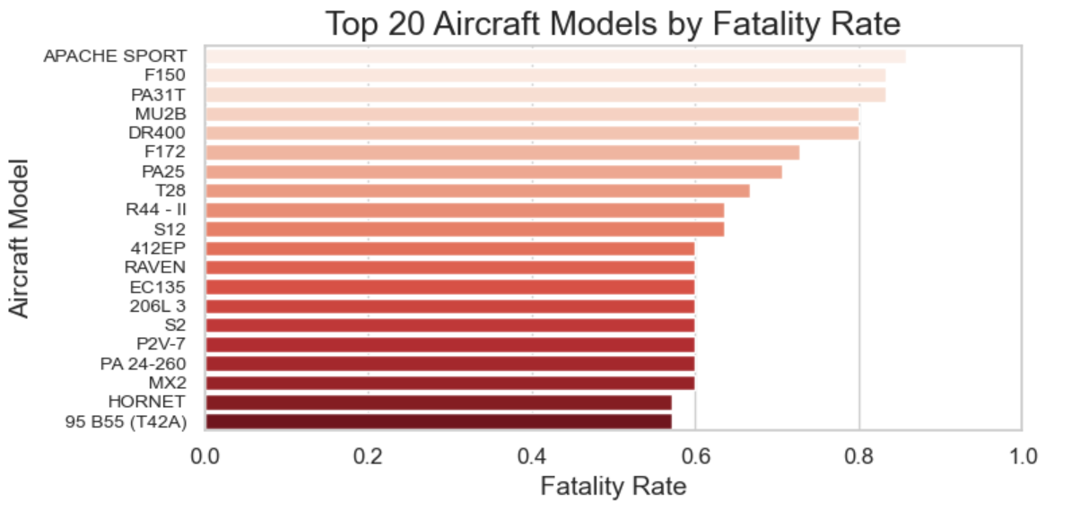

Slide 15
Additional Analysis: Aircraft Models with Fewest Accidents
A separate bar chart was created showing aircraft models with the fewest number of recorded accidents.
Focused on models with the lowest historical accident counts (bottom 15).
This analysis helped identify aircraft models that have rarely been involved in accidents, strengthening the case for low-risk purchasing.
Key Insights:
Some models consistently showed extremely low accident involvement.
Low accident history is a positive indicator for reliability and safety.
Models with both low accident counts and low fatality rates emerged as top candidates for purchase.

Slide 16
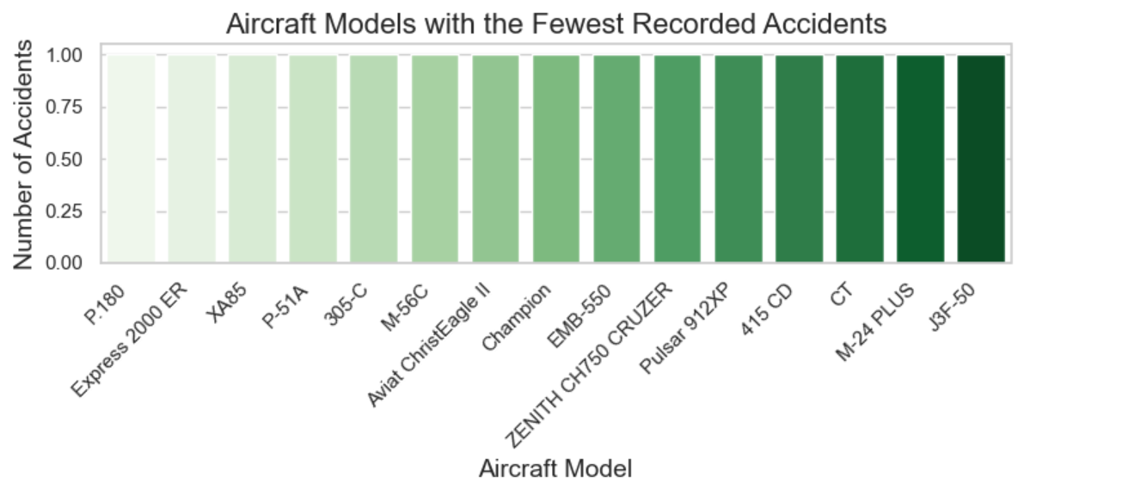

Slide 17
Visualization 4: accidents trends over the years
The line chart shows the number of aviation accidents from 1962 to 2023.
A higher number of accidents was observed between the 1960s and 1980s.
Since the late 1990s, there has been a steady decline in accident numbers.
Factors contributing to the decline include:
Improved aircraft technology
Enhanced safety regulations
Better pilot training programs
Stricter maintenance standards
In recent years, accident rates have stabilized at much lower levels.
Key Takeaway: The aviation industry has become significantly safer over time, supporting the company’s plan to invest in modern, low-risk aircraft.

Slide 18
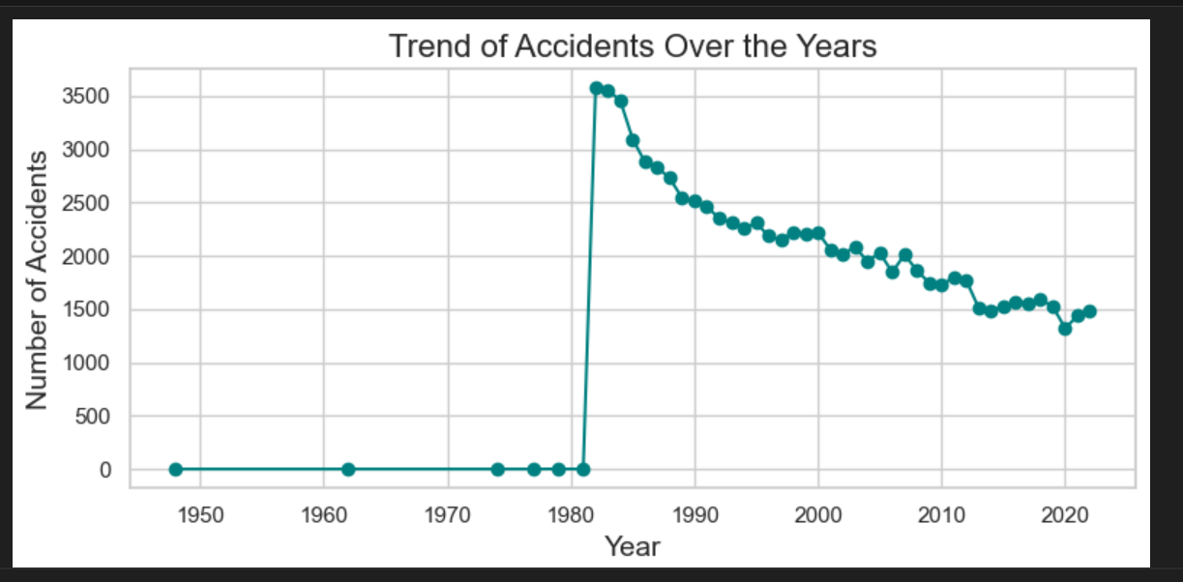

Slide 19
Insights - Aircraft Models and Accidents
🔹 High-Risk Models
Some aircraft models have significantly higher accident counts compared to others.
Models like the Cessna 172, Piper PA-28, and Beechcraft Bonanza showed a high number of incidents.
🔹 Low-Risk Models
Certain models had much fewer recorded accidents.
These models may indicate safer operation histories or lower overall usage.
🔹 Key Observation
Accident count alone does not determine risk — it must be combined with fatality rate and aircraft usage data for a complete risk profile.

Slide 20
Summary of Key Findings
Piper and Beechcraft models also showed high accident counts
.
Cessna 172 emerged as the most frequently involved aircraft in accidents, but considering its wide usage, further risk-adjusted analysis is necessary.
Certain aircraft makes like Boeing and Airbus had fewer incidents in the dataset, but this may relate to commercial flight regulations and reporting differences
.
The overall fatality rates varied significantly between models, with some models consistently associated with low fatality rates.
Models with the fewest accidents tend to be niche, less-used aircraft, often with fewer total flight hours

Slide 21
Recommendations for Aircraft Purchase
Prioritize aircraft models with a combination of low accident counts and low fatality rates (e.g., some Cessna, Piper, and Beechcraft models after closer inspection).
Avoid aircraft models that show both high accident frequency and higher fatality rates unless justified by their market share or usage context.
Focus on manufacturers with historically strong safety records and robust maintenance practices.
Consider newer models where available, as technological advancements have significantly improved aviation safety.
Further investigate usage contexts (training, private, commercial) — some models have higher incidents simply because they are heavily used for pilot training.
Implement strict maintenance and pilot training programs for any aircraft acquired, regardless of historical safety.

Slide 22
Conclusion and next steps
Through data-driven analysis, we identified lower-risk aircraft models and manufacturers suitable for the company's aviation expansion.
Key insights from accident frequency and fatality rates support safer investment decisions.
Recommended models and makes offer a balance of safety, reliability, and operational viability.
Next Steps:
Conduct further due diligence on shortlisted aircraft (e.g., maintenance records, operational history).
Consult aviation experts and pilots for real-world insights beyond the data.
Begin phased procurement starting with 1–2 aircraft to monitor operations before scaling.

